Slide 1
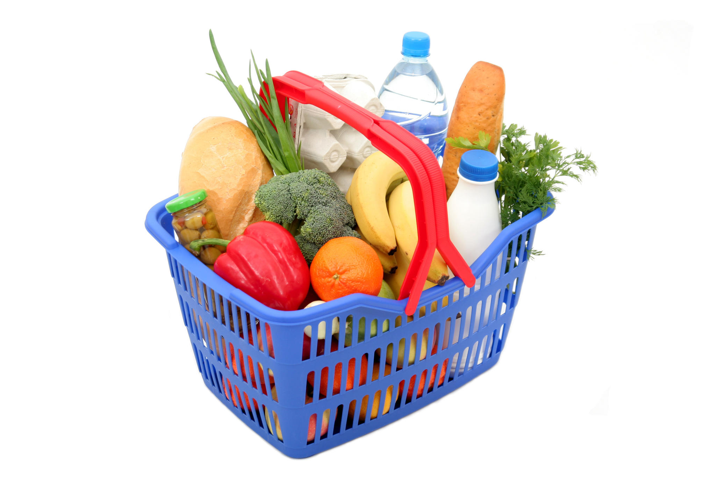
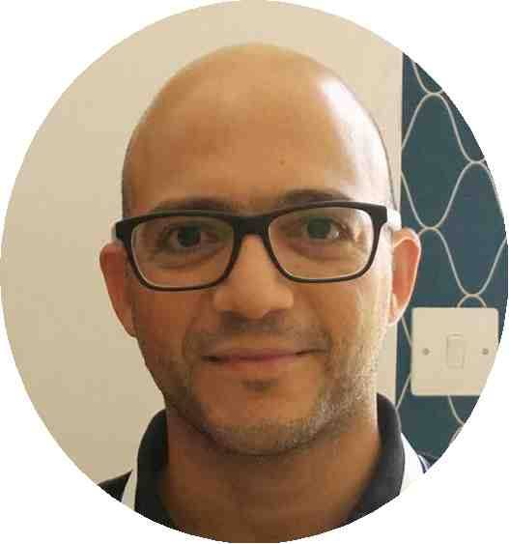
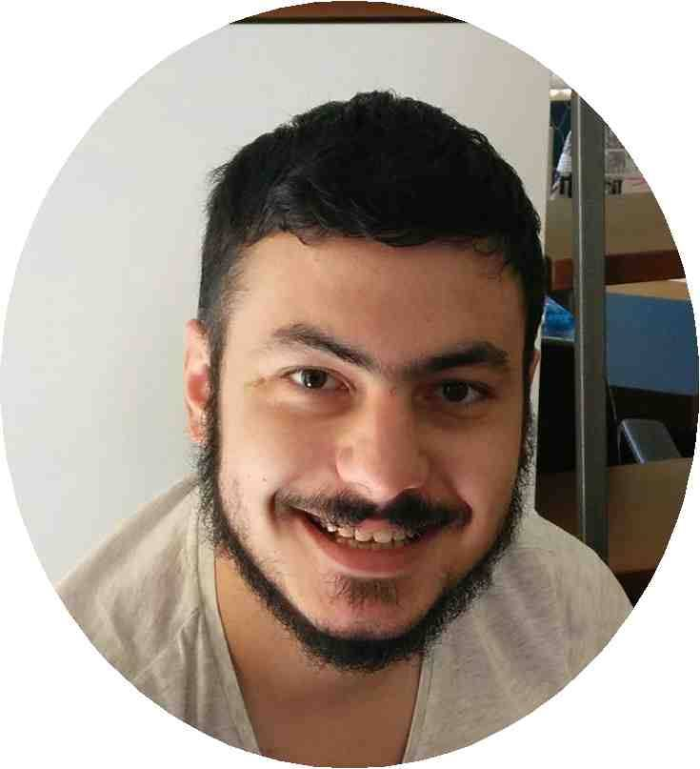
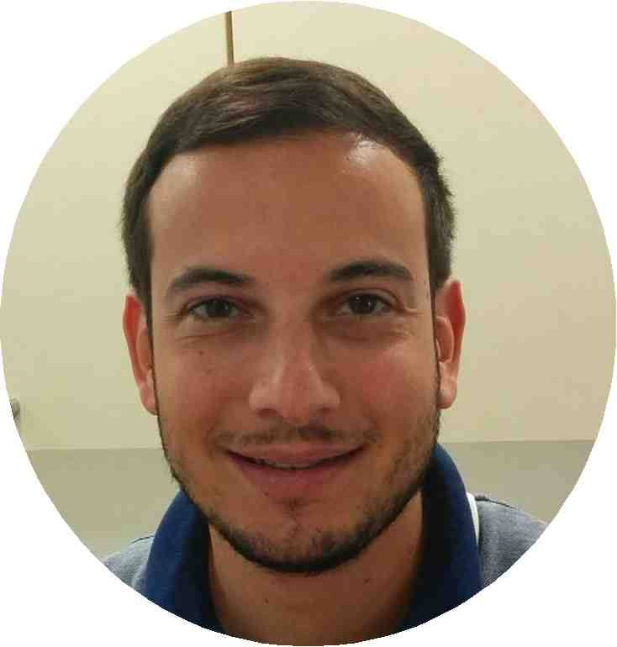

Smartbasket.com.cy
TEAM
Business
Nicholas Roussos
Business Analyst Consultant/ Chartered Accountant
Co-owner of a Pahit Ice Store
Past President of Toastmasters Nicosia Club
Cyprus Go Association Founding Member
Developer
Christos Christofidis
Freelancer Software Engineer
Microsoft Student Partner
Awards: NASA Space Apps Challenge Cyprus - 2nd Place
Business
Andreas Hadjisofocleous
Entrepreneur
President of Toastmasters Nicosia Club
Co-Founder of Global Shapers Nicosia
Awards: 3rd Prize Startup Weekend Cyprus 2013
1st Place Youth Power Competition 2013
3rd Place Digital Champion Competition 2014
Developer
Alexandros Hadjixenofontos
Software Developer

Slide 2
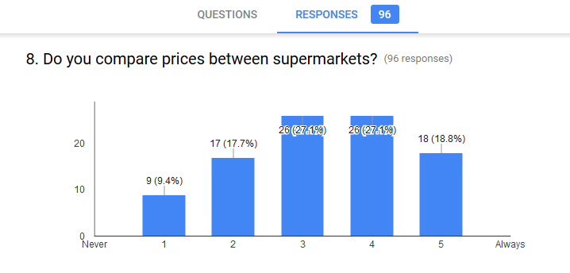
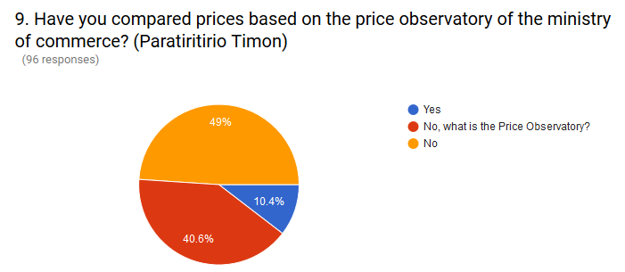
Smartbasket.com.cy
Supermarket Price Aggregator
Compare Supermarket Prices
Collects & Features Offers
Useful Statistics & Insights
Integrations:
Google Maps
Open Government Data – Price Observatory
supermarketcy.com.cy
Empowers the Consumer / Helps in the Decision Making – Where to shop?

Slide 3
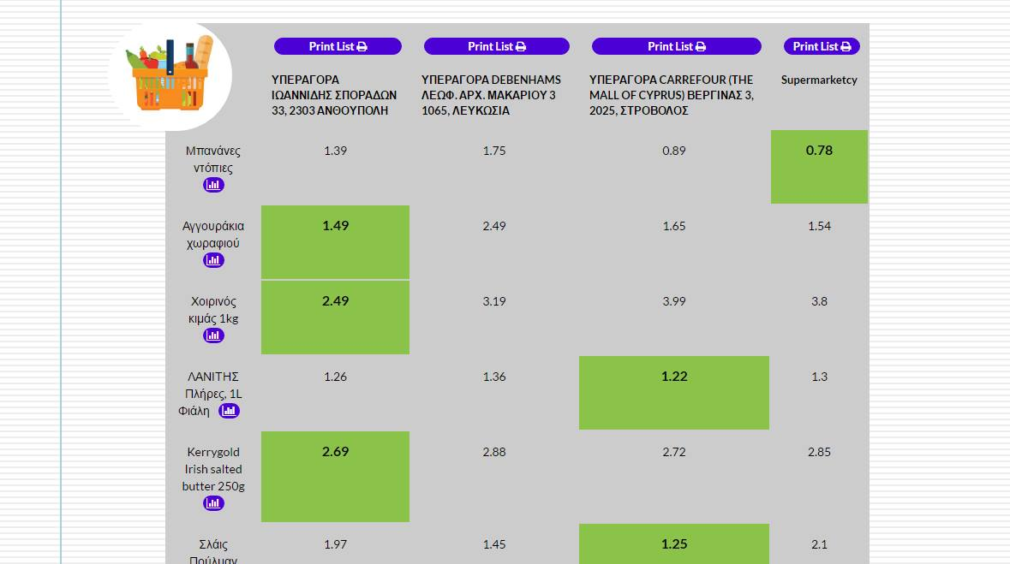
Smartbasket.com.cy
Revenue Model
Premium Model for Users (Subscription Based) – Provide Extra Features & Statistics, Offer Alerts
Sponsored Products – Google Ads Model
API With Online Supermarkets e.g supermarketcy.com.cy
Collect Behavioral Data And Sell It To Supermarkets
Advertisement Space (Targeted Ads) – Wholesalers, Distributors, Branded Products e.g Cosmos Trading, Papaellinas, Pampers, Coca Cola

